Slide 1
difference between traditional network vs blockchain
Blockchain
Blockchain is a decentralized peer-to-peer network.
A blockchain network consists of nodes, a distributed ledger, and a consensus algorithm. In some cases, it also includes smart contracts and a state database.
A blockchain network is primarily used to perform transactions and save the record of these transactions in the distributed ledger.
The traditional database
is a relational database consisting of tables and their relations.
All the data is stored in rows and columns against a specific entity.
They're mainly used to store information having logical relations between them.

Slide 2
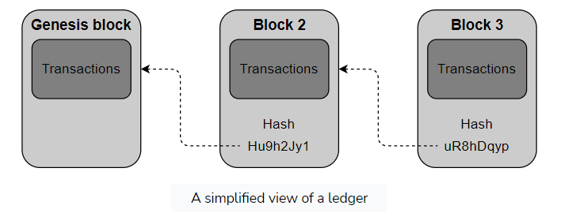
Database in a blockchain
Ledger and state databases are used in a blockchain to store information about the transactions and the network.
However, the ledger is still considered the primary storage space for the blockchain because the state database ultimately relies on the ledger to be calculated.
A ledger is a sequential structure of blocks containing chronologically arranged transactions. It's made up of sequentially linked blocks using the previous block’s hash, as shown below:

Slide 3
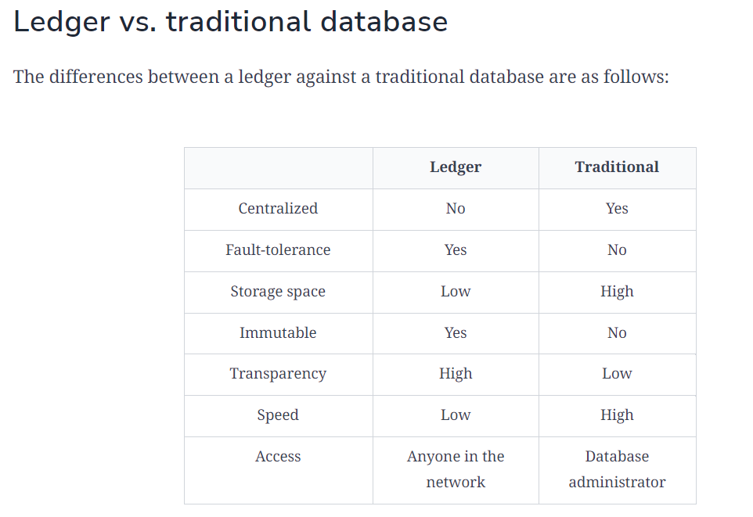

Slide 4
Centralized
Centralized refers to a situation where only a single entity (person) is in the database.
Centralized is the opposite of decentralized, where multiple entities are in charge of the database.
In traditional databases, the central authority in control of the database is the database administrator.
However, in the case of the ledger, the whole network is in control and has a copy of the ledger.
The nodes on the network can see the ledger and add to the ledger by performing a transaction.

Slide 5
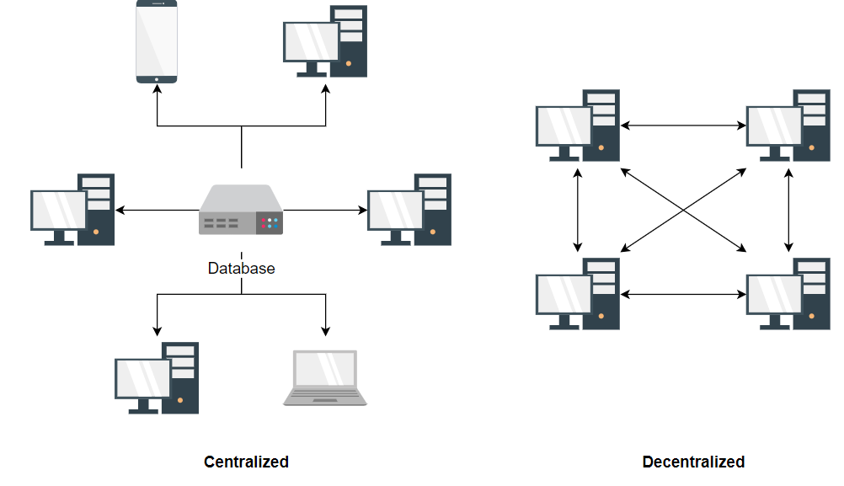

Slide 6
Fault-tolerance
Fault tolerance is the ability of a system/network to stay online after some servers/nodes crash.
Systems that are not fault-tolerant risk losing the data stored in the servers.
The traditional databases are not fault-tolerant as most of the time they rely on a single server which, when it crashes, leaves the system unusable and loses the data.
However, the ledger is replicated on all the nodes of the network, so even if some nodes go offline, the network as a whole still stays online, and the data in the ledger is accessible via the online nodes.
This makes it fault-tolerant.

Slide 7
Storage space
Traditional databases use dedicated servers with high storage capacity to store databases on, so they have a lot of storage space.
However, the ledger runs on normal computers with little storage space.
Therefore, the storage space in the ledger is limited compared to traditional databases.
Immutable
Data is considered immutable if it cannot be modified once it is added to the database.
Ledger is immutable as it doesn't allow modifying the data of the previously stored transactions as it can lead to serious repercussions for the whole network like double-spending.
However, the traditional databases are not immutable as the data, once added, can be modified by the entities with access, like a database administrator.

Slide 8
Transparency
Transparency is the ability of entities to see all the data in the database.
It's highly useful to create trust in an untrustworthy environment.
Ledger is highly transparent as everyone on the network can see the details of all the transactions from the most recent transaction leading back to the genesis block.
However, the traditional databases give access to a limited number of entities, so not everyone using the database can see all the data, thus creating an untrusted environment.
Speed
The speed with which each transaction/query is executed varies significantly as blockchains assume every node to be untrustworthy and uses a consensus algorithm to ensure that the transaction is valid, thus taking more time.
However, in traditional databases, this problem is not as persistent as the entities with access to modify the database are assumed to be trustworthy, so they do not require a consensus algorithm to ensure that the query is valid.
This leads to an increase in the query execution speed, thus making the traditional databases faster than the ledger.

Slide 9
Access
Every node in the network can access the ledger to view and add transactions.
However, traditional databases give access to a limited number of trustworthy entities to execute queries on the database, meaning database administrators, managers, and so on.
Conclusion
Ledger, although considered to be a database, has a very specific use case as compared to traditional databases.
Ledger offers some advantages over the traditional bases.
However, the traditional databases still serve as a good option for applications today because the ledger only stands out as a good option in an untrustworthy environment.

Slide 10
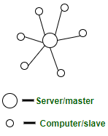
Centralized, Decentralized and Distributed Systems
1. CENTRALIZED SYSTEMS:
Centralized systems are systems that use client/server architecture where one or more client nodes are directly connected to a central server.
This is the most commonly used type of system in many organizations where a client sends a request to a company server and receives the response.

Slide 11
Characteristics of Centralized Systems
Run on a single computer system and do not interact with another computer system.
A modern, general-purpose computer system consists of one to a few processors and a number of device controllers that are connected through a common bus that provides access to shared memory.
The processors have local cache memories that store local copies of parts of the memory, to speed up access to data.
Centralized systems have specialized device controllers responsible for managing various hardware components, such as disk drives and audio devices
A typical single-user system is a desktop unit used by a single person, usually with only one processor and one or two hard disks, and usually only one person using the machine at a time.
A typical multiuser system, has more disks and more memory and may have multiple processors. It serves a large number of users who are connected to the system remotely.
Database systems designed for use by single users usually do not provide many of the facilities that a multiuser database provides.
Centralized systems can have multiple processors, and fine-grained parallelism is a characteristic that may be present in some centralized systems to improve performance

Slide 12
Characteristics of Centralized System –
Presence of a global clock: As the entire system consists of a central node(a server/ a master) and many client nodes(a computer/ a slave), all client nodes sync up with the global clock(the clock of the central node).
One single central unit: One single central unit which serves/coordinates all the other nodes in the system.
Dependent failure of components: Central node failure causes the entire system to fail. This makes sense because when the server is down, no other entity is there to send/receive responses/requests.
Components of Centralized System –
Node (Computer, Mobile, etc.).
Server.
Communication link (Cables, Wi-Fi, etc.).

Slide 13
Limitations of Centralized System –
Can’t scale up vertically after a certain limit – After a limit, even if you increase the hardware and software capabilities of the server node, the performance will not increase appreciably leading to a cost/benefit ratio < 1.
Bottlenecks can appear when the traffic spikes – as the server can only have a finite number of open ports to which can listen to connections from client nodes.
So, when high traffic occurs like a shopping sale, the server can essentially suffer a Denial-of-Service attack or Distributed Denial-of-Service attack.

Slide 14
Advantages of Centralized System –
Easy to physically secure. It is easy to secure and service the server and client nodes by virtue of their location
Smooth and elegant personal experience – A client has a dedicated system which he uses(for example, a personal computer) and the company has a similar system which can be modified to suit custom needs
Dedicated resources (memory, CPU cores, etc)
More cost-efficient for small systems up to a certain limit – As the central systems take fewer funds to set up, they have an edge when small systems have to be built
Quick updates are possible – Only one machine to update.
Easy detachment of a node from the system. Just remove the connection of the client node from the server and voila! Node detached.
Centralized control: In a centralized system, the central authority has complete control over the system, which can lead to better coordination and decision-making.

Slide 15
Disadvantages of Centralized System –
Highly dependent on the network connectivity – The system can fail if the nodes lose connectivity as there is only one central node.
No graceful degradation of the system – abrupt failure of the entire system
Less possibility of data backup. If the server node fails and there is no backup, you lose the data straight away
Difficult server maintenance – There is only one server node and due to availability reasons, it is inefficient and unprofessional to take the server down for maintenance.
So, updates have to be done on-the-fly(hot updates) which is difficult and the system could break.
Single point of failure: Centralized systems have a single point of failure, which can cause the entire system to fail if the central node goes down.
Lack of transparency: Centralized systems lack transparency as the central authority has complete control over the system, which can lead to issues like censorship and bias.
Security risks: Centralized systems are more vulnerable to security risks as the central authority has complete access to all the data.

Slide 16
Applications of Centralized System –
Application development – Very easy to set up a central server and send client requests. Modern technology these days do come with default test servers which can be launched with a couple of commands. For example, Express server, Django server.
Data analysis – Easy to do data analysis when all the data is in one place and available for analysis
Personal computing.
Use Cases –
Centralized databases – all the data in one server for use.
Single-player games like Need For Speed, GTA Vice City – an entire game in one system(commonly, a Personal Computer)
Application development by deploying test servers leading to easy debugging, easy deployment, easy simulation
Personal Computers

Slide 17
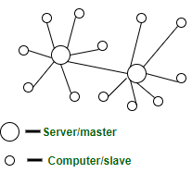
DECENTRALIZED SYSTEMS:
These are other types of systems that have been gaining a lot of popularity, primarily because of the massive hype of Bitcoin.
Now many organizations are trying to find the application of such systems.
In decentralized systems, every node makes its own decision.
The final behavior of the system is the aggregate of the decisions of the individual nodes.
Note that there is no single entity that receives and responds to the request.

Slide 18
DECENTRALIZED SYSTEMS:
These are other types of systems that have been gaining a lot of popularity, primarily because of the massive hype of Bitcoin.
Now many organizations are trying to find the application of such systems.
In decentralized systems, every node makes its own decision.
The final behavior of the system is the aggregate of the decisions of the individual nodes.
Note that there is no single entity that receives and responds to the request.
Characteristics of Decentralized System –
Lack of a global clock: Every node is independent of each other and hence, has different clocks that they run and follow.
Multiple central units (Computers/Nodes/Servers): More than one central unit which can listen for connections from other nodes
Dependent failure of components: one central node failure causes a part of the system to fail; not the whole system

Slide 19
DECENTRALIZED SYSTEMS:
Components of Decentralized System are,
Node (Computer, Mobile, etc.)
Communication link (Cables, Wi-Fi, etc.)
Architecture of Decentralized System –
peer-to-peer architecture – all nodes are peers of each other. No one node has supremacy over other nodes
master-slave architecture – One node can become a master by voting and help in coordinating of a part of the system but this does not mean the node has supremacy over the other node which it is coordinating
Limitations of Decentralized System –
May lead to the problem of coordination at the enterprise level – When every node is the owner of its own behavior, its difficult to achieve collective tasks
Not suitable for small systems – Not beneficial to build and operate small decentralized systems because of the low cost/benefit ratio
No way to regulate a node on the system – no superior node overseeing the behavior of subordinate nodes

Slide 20
Advantages of Decentralized System –
Minimal problem of performance bottlenecks occurring – The entire load gets balanced on all the nodes; leading to minimal to no bottleneck situations
High availability – Some nodes(computers, mobiles, servers) are always available/online for work, leading to high availability
More autonomy and control over resources – As each node controls its own behavior, it has better autonomy leading to more control over resources.
Improved fault tolerance: Decentralized systems are designed to be fault tolerant, meaning that if one or more nodes fail, the system can still continue to function. This is because the workload is distributed across multiple nodes, rather than relying on a single point of failure.
Increased transparency: Decentralized systems often have a transparent and open structure, which allows for greater accountability and trust. Each node has access to the same information, making it more difficult to manipulate or corrupt the data.

Slide 21
Advantages of Decentralized System –
Greater security: Decentralized systems can be more secure than centralized systems because there is no single point of failure or vulnerability that can be exploited by attackers. Data is distributed across multiple nodes, making it more difficult to hack or compromise.
Improved scalability: Decentralized systems can be more scalable than centralized systems because adding new nodes to the network can help to distribute the workload and increase capacity. This can be particularly useful for large, complex systems that need to be able to handle high volumes of traffic or data.

Slide 22
Disadvantages of Decentralized System –
Difficult to achieve global big tasks – No chain of command to command others to perform certain tasks
Difficult to know which node failed – Each node must be pinged for availability checking and partitioning of work has to be done to actually find out which node failed by checking the expected output with what the node generated
Difficult to know which node responded – When a request is served by a decentralized system, the request is actually served by one of the nodes in the system but it is actually difficult to find out which node indeed served the request.
Security challenges: Decentralized systems can be vulnerable to security threats such as DDoS attacks, sybil attacks, and 51% attacks. These attacks can compromise the integrity and security of the network, leading to data breaches and loss of trust.
Lack of scalability: Decentralized systems can face scalability issues as the number of nodes increases. This is because each node needs to maintain a copy of the entire database, which can be difficult to manage as the database grows.

Slide 23
Applications of Decentralized System –
Private networks – peer nodes joined with each other to make a private network.
Cryptocurrency – Nodes joined to become a part of a system in which digital currency is exchanged without any trace and location of who sent what to whom. However, in bitcoin, we can see the public address and amount of bitcoin transferred, but those public addresses are mutable and hence difficult to trace.
Use Cases –
Blockchain.
Decentralized databases – Entire databases split into parts and distributed to different nodes for storage and use. For example, records with names starting from ‘A’ to ‘K’ in one node, ‘L’ to ‘N’ in the second node, and ‘O’ to ‘Z’ in the third node
Cryptocurrency.

